Slide 1
ECE408 / CS483 Spring 2018 Applied Parallel Programming Lecture 23: GPU as part of the PC Architecture

Slide 2
Objective
To understand the major data transfer factors that dictate performance when using GPU as a compute co-processor for the CPU
The speeds and feeds of the traditional CPU world
The speeds and feeds when employing a GPU
To form a solid knowledge base for performance programming in modern GPU’s

Slide 3
Review- Common Structure of a CUDA Program
Global variables declaration
Function prototypes
__global__ void kernelOne(…)
Main ()
allocate memory space on the device – cudaMalloc(&d_GlblVarPtr, bytes )
transfer data from host to device – cudaMemcpy(d_GlblVarPtr, h_Gl…)
execution configuration setup
kernel call – kernelOne<<<execution configuration>>>( args… );
transfer results from device to host – cudaMemcpy(h_GlblVarPtr,…)
optional: compare against golden (host computed) solution
repeat
as needed

Slide 4
Bandwidth – Gravity of Modern Computer Systems
The Bandwidth between key components ultimately dictates system performance
Especially true for massively parallel systems processing massive amount of data
Tricks like buffering, reordering, caching can temporarily defy the rules in some cases
Ultimately, the performance falls back to what the “speeds and feeds” dictate

Slide 5
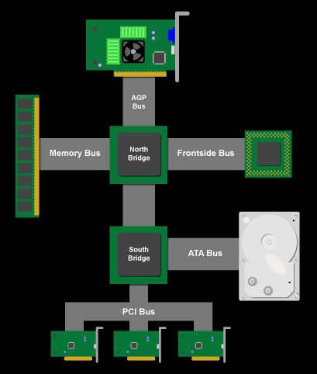
Classic (Historical) PC Architecture
Northbridge connects 3 components that must communicate at high speed
CPU, DRAM, video
Video also needs to have 1st-class access to DRAM
Previous NVIDIA cards are connected to AGP, up to 2 GB/s transfers
Southbridge serves as a concentrator for slower I/O devices
CPU
Core Logic Chipset

Slide 6
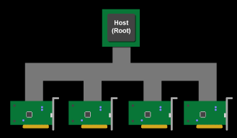
(Original) PCI Bus Specification A Humble Beginning
Connected to the southBridge
Originally 33 MHz, 32-bit wide, 132 MB/second peak transfer rate
Later, 66 MHz, 64-bit, 528 MB/second peak
Upstream bandwidth remain slow for device (~256MB/s peak)
Shared bus with arbitration
Winner of arbitration becomes bus master and can connect to CPU or DRAM through the southbridge and northbridge

Slide 7
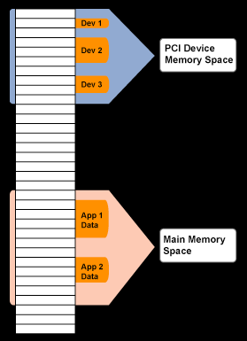
PCI as Memory Mapped I/O
PCI device registers are mapped into the CPU’s physical address space
Accessed through loads/ stores (kernel mode)
Addresses are assigned to the PCI devices at boot time
All devices listen for their addresses

Slide 8
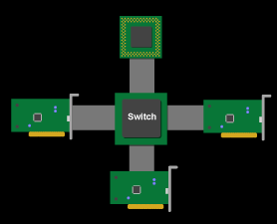
PCI Express (PCIe)
Switched, point-to-point connection
Each card has a dedicated “link” to the central switch, no bus arbitration.
Packet switches messages form virtual channel
Prioritized packets for QoS
E.g., real-time video streaming

Slide 9
PCIe Generations
Within each generation, the links can be scaled by making it wider
X1, x2, x4, x8, x16, x32,…
The goal is to double the speed with each new generation

Slide 10
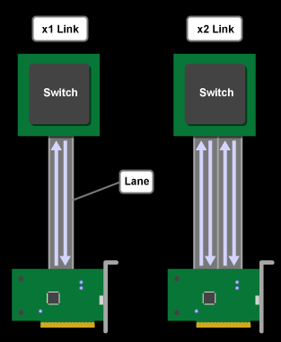
PCIe Gen 3 Links and Lanes
Each link consists of one or more lanes
Each lane is 1-bit wide (4 wires, each 2-wire pair can transmit 8Gb/s in one direction)
Upstream and downstream simultaneous and symmetric
Each Link can combine 1, 2, 4, 8, 12, 16 lanes- x1, x2, etc.
Each byte data is 128b/130b encoded into 130 bits with equal number of 1’s and 0’s; net data rate 7.8768 Gb/s per lane each way.
Thus, the net data rates are 985 MB/s (x1) 1.97 GB/s (x2), 3.94 GB/s (x4), 7.9 GB/s (x8), 15.8 GB/s (x16), each way
Notes:
130

Slide 11
Foundation: 8/10 bit encoding
Goal is to maintain DC balance while have sufficient state transition for clock recovery
The difference of 1s and 0s in a 20-bit stream should be ≤ 2
There should be no more than 5 consecutive 1s or 0s in any stream
00000000, 00000111, 11000001 bad
01010101, 11001100 good
Find 256 good patterns among 1024 total patterns of 10 bits to encode an 8-bit data
An 20% overhead

Slide 12
Current: 128/130 bit encoding
Same goal: maintain DC balance while have sufficient state transition for clock recovery
1.5% overhead instead of 20%
Scrambler function: long runs of 0s, 1s vanishingly small
Instead of guaranteed run length of 8/10b
At least one bit shift every 66 bits

Slide 13
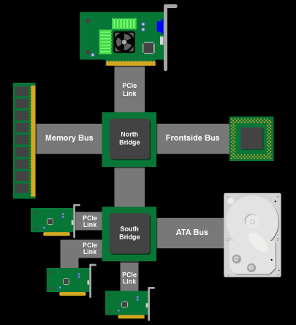
Recent PCIe PC Architecture
PCIe forms the interconnect backbone
Northbridge/Southbridge are both PCIe switches
Some Southbridge designs have built-in PCI-PCIe bridge to allow old PCI cards
Some PCIe I/O cards are PCI cards with a PCI-PCIe bridge
Source: Jon Stokes, PCI Express: An Overview
http://arstechnica.com/articles/paedia/hardware/pcie.ars
Current systems integrate PCIe controllers onto CPU

Slide 14
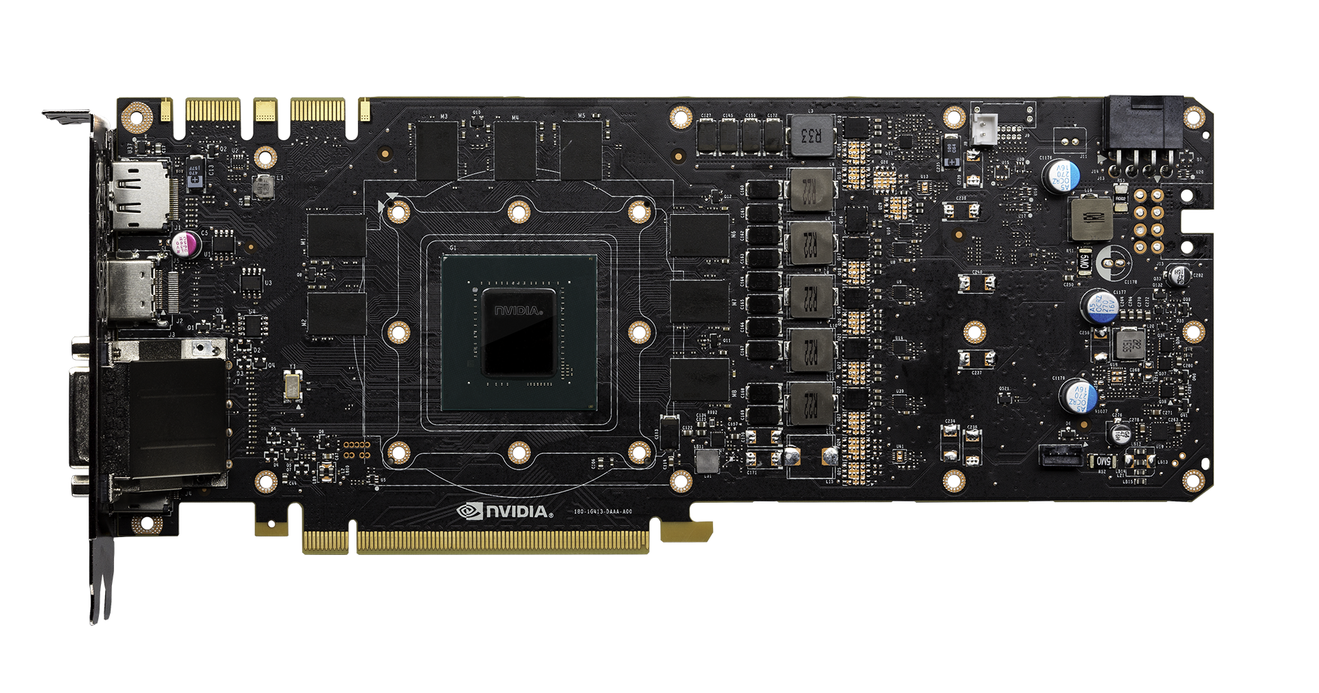
GeForce GTX 1080 (Pascal) GPU Consumer Card Details
SLI Connector
DP Out
HDMI Out
DVI Out
8GB/256-bit GDDR5X
1.25 GHz mem clock
2.5 GHz write clock w/ QDR = 10Gb/s/pin
256 bit bus = 320 GB/s
8 pieces of 8Gb (16 Mb x 32 x 16 banks)
16x PCI-Express

Slide 15
PCIe Data Transfer using DMA
DMA (Direct Memory Access) is used to fully utilize the bandwidth of an I/O bus
DMA uses physical address for source and destination
Transfers a number of bytes requested by OS
Needs pinned memory
Main Memory (DRAM)
CPU
GPU card
(or other I/O cards)
Global Memory
DMA

Slide 16
Pinned Memory
DMA uses physical addresses
The OS could accidentally page out the data that is being read or written by a DMA and page in another virtual page into the same location
Pinned memory cannot not be paged out
If a source or destination of a cudaMemCpy() in the host memory is not pinned, it needs to be first copied to a pinned memory – extra overhead
cudaMemcpy is much faster with pinned host memory source or destination

Slide 17
Allocate/Free Pinned Memory (a.k.a. Page Locked Memory)
cudaHostAlloc()
Three parameters
Address of pointer to the allocated memory
Size of the allocated memory in bytes
Option – use cudaHostAllocDefault for now
cudaFreeHost()
One parameter
Pointer to the memory to be freed

Slide 18
Using Pinned Memory
Use the allocated memory and its pointer the same way those returned by malloc();
The only difference is that the allocated memory cannot be paged by the OS
The cudaMemcpy function should be about 2X faster with pinned memory
Pinned memory is a limited resource whose over-subscription can have serious consequences

Slide 19
Important Trends
Knowing yesterday, today, and tomorrow
The PC world is becoming flatter
CPU and GPU are being fused together
Outsourcing of computation is becoming easier…

Slide 20
Any Moe Questions?

